Slide 1

Drafting
A Comprehensive Guide
Lecture 8

Slide 2
Key points
What is drafting
Importance of drafting
Thesis statement
Topic sentence
Sequences of drafting
Types of Draft
Key elements of Draft
Digital tools and techniques for drafting
Long vs Shorts Draft

Slide 3

Unlocking Your Writing Potential: The Power of Drafting
Drafting is essential in the writing process.
It helps generate ideas and refine arguments.
Drafting is not just writing but thinking on paper.

Slide 4
Introduction
The drafting stage is where you really begin writing.
The most important thing here is to get words onto paper.
Don’t worry about grammar, spelling, punctuation or the best wording.
Draft is a piece of writing which will probably be changed and improved: not the final copy!
The dictionary definition says, “a draft is preliminary piece of writing”.
Writing more than one draft allows you to develop your ideas and to find the best way to present your ideas to your reader.

Slide 5

Rough Draft
A rough draft is the first version of your piece written with complete sentences and paragraphs. It doesn’t have to be polished—this is where you get your thoughts down without worrying too much about wording or mechanics. The goal is to create a complete version of your piece that you can improve and refine later.

Slide 6
Introduction to Drafting
The process of creating a preliminary version of a written work.
Write sentences and paragraphs even if they are not perfect.
Create a thesis statement with your main idea.
A thesis statement is a sentence that sums up the central point of your paper or essay.
Example
Climate change poses an existential threat to the global economy, and the transition to a low-carbon economy, while challenging, presents significant opportunities for innovation and sustainable growth.

Slide 7

Importance
Drafting helps organize ideas, explore concepts, and establish structure.

Slide 8
Why Drafting Matters
Encourages creativity
Identify gaps in logic
A foundation for revision

Slide 9
Steps to Start Drafting
Review your prewriting notes.
Create an outline.
Begin writing without overthinking.

Slide 10
Some sequences to organize a Draft
Chronology
Spatial
Importance
Problem/Solution
Comparison/Contrast

Slide 11
Chronological Writing
Method of organization to present events and actions as they occurred in time, e.g., Narrative Essays.
"I woke up early, feeling excited for my first day of college. After getting dressed, I grabbed my backpack and left for campus. My first class was at 8 AM, and I made sure to arrive early. The professor introduced the course, and we spent the rest of the hour discussing the syllabus. By lunchtime, I had already met a few classmates, making the transition much easier. As the day ended, I felt relieved and eager to continue my journey."

Slide 12
Spatial Writing
Spatial writing describes objects, places, or scenes based on their location and arrangement in space. It often moves from left to right, top to bottom, or near to far. e.g.
"As I entered the cozy living room, the first thing I noticed was the large, plush sofa against the far wall, bathed in the soft glow of a nearby lamp. To the left of the sofa, a wooden coffee table sat adorned with a stack of books and a steaming cup of tea.....”

Slide 13
Writing for Importance
To highlight the significance of a subject matter.
"The most crucial reason to adopt renewable energy is its impact on reducing climate change. Fossil fuels release carbon dioxide, which traps heat and leads to global warming. Additionally, renewable energy sources like solar and wind are more sustainable, ensuring long-term energy security. Finally, investing in green energy creates jobs, boosting economic growth while protecting the environment. Given these benefits, transitioning to renewables is essential for a sustainable future."

Slide 14
Writing for Problem/Solution
Problem-solution writing presents an issue, explains its significance, and then offers potential solutions.
Problem: Many students struggle to access quality education due to financial constraints and geographical barriers. This educational gap limits opportunities for personal and professional growth.
Solution: One solution is expanding online learning platforms, making quality education more accessible to students worldwide. Schools and governments can also provide low-cost or free internet access to underprivileged communities. Additionally, scholarship programs can support students who lack financial resources.

Slide 15
Writing for Comparison/Contrast
To provide a comparative analysis.
Public Schools "Public schools are government-funded and open to all students, making them more accessible. They offer diverse student populations, exposing children to different cultures and backgrounds. However, they often have larger class sizes, which can make it challenging for teachers to provide individual attention."
Private Schools "Private schools, on the other hand, charge tuition and often have smaller class sizes, allowing for a more personalized education. They may offer specialized curriculums or religious education. However, the cost can be a barrier for many families, and admission is selective."
Conclusion
Both public and private schools offer quality education, but the choice depends on financial factors, class size preferences, and specific academic needs.

Slide 16
Pre-writing vs Drafting
Turning ideas into a structured written form
Brainstorming, researching, and outlining

Slide 17
Types of Drafts
Draft
Rough
Final
Working

Slide 18

Rough Draft
It is a piece of text, a formal suggestion, or a drawing in its original state, often but not the developed form. containing the main ideas and intentions.

Slide 19
Rough Draft
You write a rough draft by letting the ideas flow freely and then craft a structure for your thoughts.
Follow a specific structure.
Alternatively, restructure your ideas to follow a certain order.
A strong sense of organization that supports your main idea.
You are clear about the reason to choose a specific structure for your ideas.

Slide 20
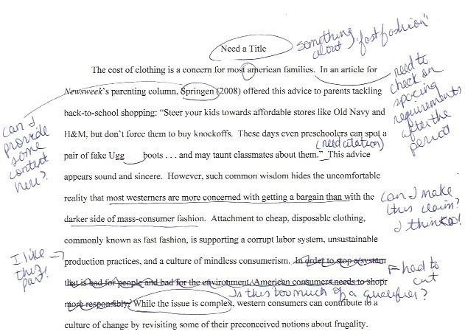

Slide 21
Working Draft
A "working draft" is a preliminary version of a document, like a first draft or rough draft, that is still in progress and subject to revisions and improvements.
It's a stage where ideas are fleshed out and the structure and content are explored before the final product is created.

Slide 22
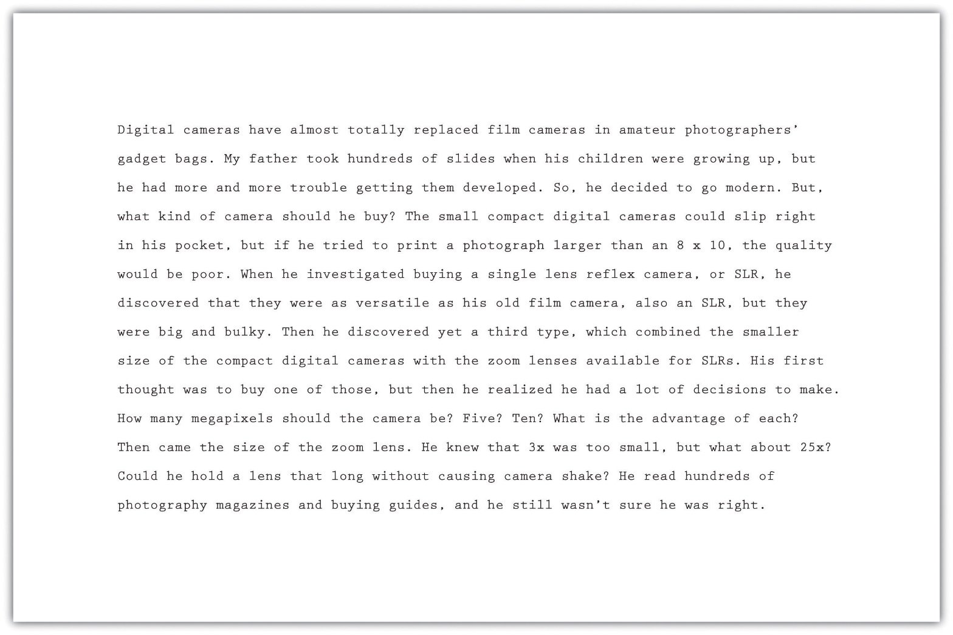

Slide 23
Final Draft
A final draft is the polished version of a piece of writing that has undergone revisions, proofreading, and editing.
It is the completed version that is ready for submission or publication.
The final draft should be well-organized, free of grammar and spelling errors, and clearly convey the intended message.

Slide 24
Examples of Final Draft
First Draft: "Yesterday, I go to the park and see a dog. It was very cute, and I pet it. Then I play soccer with my friends."
Final Draft: "Yesterday, I went to the park and saw a cute dog. I petted it before joining my friends for a game of soccer."

Slide 25
Examples of Final Draft
First Draft: "School uniforms should be required because they help students focus. They also make everyone feel the same. People won’t worry about clothes, and it stops bullying."
Final Draft: "Requiring school uniforms can improve students' focus by eliminating distractions related to clothing choices. Additionally, uniforms promote equality, reducing social pressure and bullying based on attire."

Slide 26
Key Elements of a Draft
Structure: Introduction, body, conclusion.
Content: Main ideas, supporting details, evidence.
Flow: Logical progression of ideas.

Slide 27
Writing the Introduction
Purpose: Hook the reader and present the main idea.
Techniques: Use a quote, question, or anecdote.

Slide 28
Developing the Body
Organize paragraphs by main ideas.
Use evidence (examples, data, quotes) to support arguments.
Ensure smooth transitions between paragraphs.

Slide 29
Crafting the Conclusion
Summarize key points.
Restate the main idea.
End with a call to action or thought-provoking statement.

Slide 30
Writing Freely
Don’t worry about grammar or style.
Focus on getting ideas down.
Perfection comes later during revision.

Slide 31
Using Outlines
Benefits: Provides structure and direction.
Example:
I. Introduction
II. Main Point 1
III. Main Point 2
IV. Conclusion

Slide 32
Incorporating Evidence
Types: Statistics, quotes, examples, anecdotes.
Importance: Adds credibility and depth to your writing.

Slide 33
Maintaining Focus
Stick to the main idea.
Avoid tangents or irrelevant details.
Use your outline as a guide.

Slide 34
Writing for Your Audience
Consider who will read your work.
Adjust tone, language, and content accordingly.

Slide 35
Writing for Different Genres
Academic: Formal tone, evidence-based.
Creative: Expressive, imaginative.
Professional: Clear, concise, goal-oriented.

Slide 36
Common Drafting Challenges
Writer’s block.
Overthinking.
Lack of clarity or direction.

Slide 37
What is Writer's block
Writer's block is a condition where a writer struggles to start or continue writing due to a lack of ideas, motivation, or confidence.
It can happen to anyone, from students to professional authors, and may last for a short time or an extended period.

Slide 38
Overcoming Writer’s Block
Write freely without self-editing.
Use prompts or questions to spark ideas.
Take breaks to refresh your mind.

Slide 39
Tools for Drafting
Word processors (e.g., Microsoft Word, Google Docs).
Note-taking apps (e.g., Evernote, Notion).
Mind-mapping tools (e.g., MindMeister).

Slide 40
Collaborative Drafting
Benefits: Feedback, diverse perspectives.
Tools: Google Docs, shared folders.

Slide 41
Time Management in Drafting
Set deadlines for each section.
Use timers or productivity techniques (e.g., Pomodoro).

Slide 42
Pomodoro Technique
The Pomodoro Technique is a time management method that uses a timer to break work into
focused intervals (traditionally 25 minutes, called a "pomodoro") separated by short breaks,
promoting focused work and rest periods to improve productivity and avoid burnout.

Slide 43
Drafting Long-Form Content
Break into sections or chapters.
Focus on one section at a time.

Slide 44
Drafting Short-Form Content
Be concise and to the point.
Focus on clarity and impact.

Slide 45
Common Mistakes in Drafting
Over-editing too soon.
Lack of structure.
Ignoring the audience.

Slide 46
Conclusion
Drafting is a crucial step in the writing process.
Focus on content and structure first.
Revise and refine later.
Call to action: "Start drafting today and watch your writing improve!“

